Slide 1
Credit Card Default Clients database evaluation
SingRs
Shahan ASHRAF
Fabio BRITO DA FONSECA
Alana HARRIS
Dimitar MILENKOV
Misha OBOLONSKYI
January 2019

Slide 2
Overview
A major eastern-European bank wants to better predict the likelihood of default for its customers, as well as identify the key drivers that determine this likelihood.
The bank collected data on 25000 of their existing clients. Of those, 1000 were randomly selected to participate in a Data Analytics pilot project, in which a model has to predict the clients that will default a short-term credit line provided.
The model was generate using the remaining 24000 clients.
The ultimate question:
To which of the 1000 “new applicants” in the pilot should be issued credit?

Slide 3
Data Adjustment
In this phase, we took a closer look on the available data in order to better understand it and perform the proper adjustments for the modeling phase.
The following modifications were made:
Removal of wrong or missing values, categorizing those registries as “Other”
Separation of variable pay_X in three new variables
PAY_NONEED_X
PAY_FULL_X
PAY_ROLLING_X
Change data types to better reflect what the variable means (e.g factor, integer, logical, etc.)

Slide 4
Methods applied
To prepare the data for modeling, the 24000 clients were divided in two groups, in which the training one would be used to generate the models and the testing one to validate it.
Training – 23000 clients
Testing – 1000 clients
Methods applied:
StepAIC
cTree
rPart
RandomForest
xgBoost

Slide 5
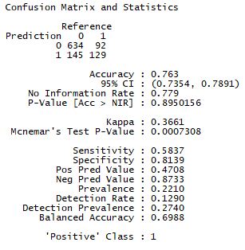
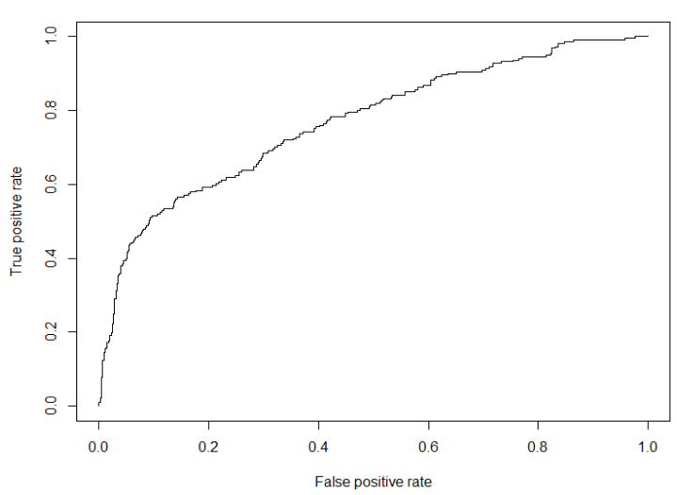
Results - StepAIC
asdasd
[1] 0.769103

Slide 6
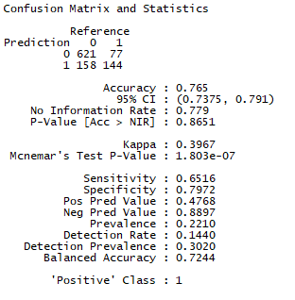
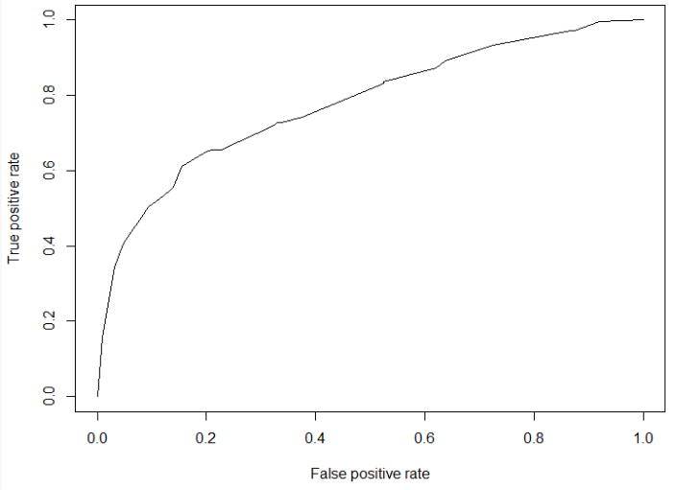
Results - cTree
asdasd
[1] 0.7785245

Slide 7
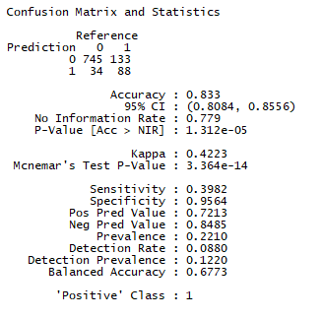
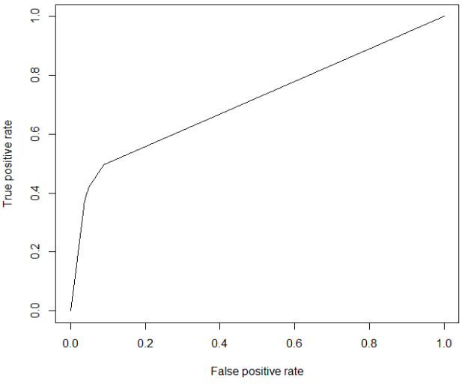
Results - rPart
asdasd
[1] 0.7113395

Slide 8
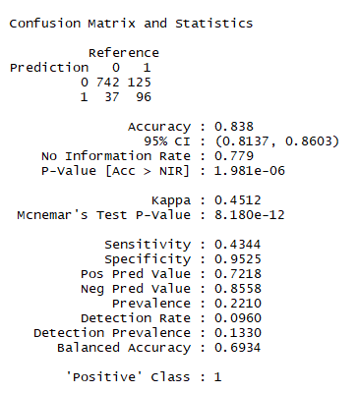
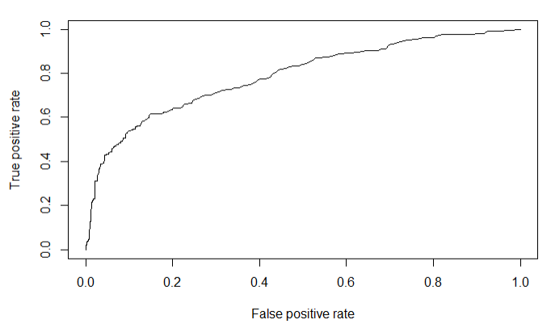
Results - RandomForest
asdasd
0.7889945

Slide 9
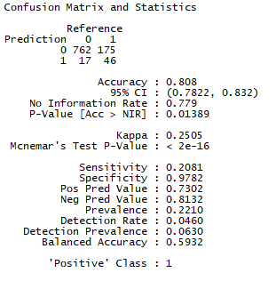
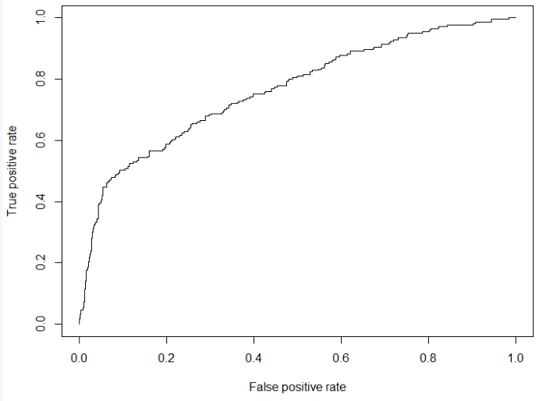
Results - xgBoost
asdasd
[1] 0.7652635

Slide 10
Conclusion
Method | Good | Bad | Revenue | Loss | Profit
stepAIC | 634 | 92 | $ 951.000 | $ -460.000 | $ 491.000
cTree | 621 | 77 | $ 931.500 | $ -385.000 | $ 546.500
rPart | 745 | 133 | $ 1.117.500 | $ -665.000 | $ 452.500
randomForest | ? | ? | ? | ? | ?
xgboost | 762 | 175 | $ 1.143.000 | $ -875.000 | $ 268.000
asdasd

